Slide 1
Team 8 - History of Open World Game
By: Aidan Brown, Brandon Leung, Rudhnan Habib, Luke Magnotta

Slide 2
Description
This website will outline the history of open world games, from the first non-linear adventures on Atari in the early 80s to massive modern games like Starfield and Tears of the Kingdom.
Users navigate through our index page, which includes a revolving carousel of images of all featured games, right next to a button that will take the user to a random subpage.
Right under that is our websites main focus, the timeline. It presents in order of release every game on the page, which are all games that impacted the open world genre in some way.
Once an image for a game is clicked, the user is brought to that games subpage. There, the user can read more about the game, view an image from the game, and click on a link that brings them to an external website featuring more information about the game.

Slide 3
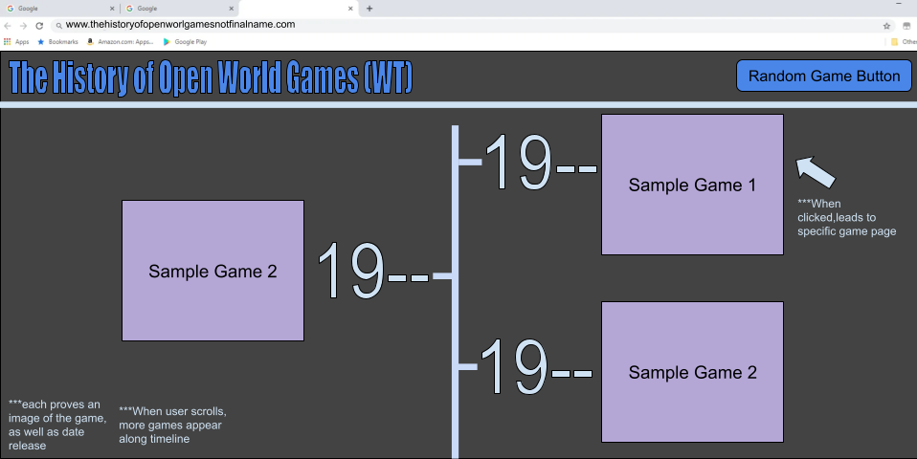
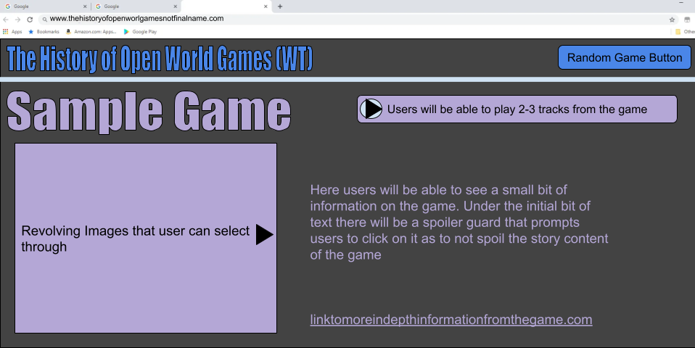
Preliminary Sketch
Sketch for Main Page
Sketch for Sub Pages

Slide 4
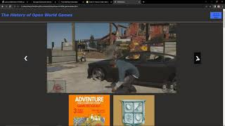
Demonstration

Slide 5
HTML5
Main Page
The main page was split up into separate divs for the header, slideshow, and timeline. With both the slideshow and timeline having sub-divs for their respective elements. The main elements used within those divs consisted of h1, h3, a, & img. Each of the timeline elements contained a image of the games cover art and a h3 displaying the date or year of the game’s first release.
Sub page
The main elements we used for the sub pages in regards to HTML were h1, h3, p, img, and a. These were all used to display information about the subpages given game, like screenshots and a information about a games release and insights on its impacts. Divs were used to organize the page itself and to help with the styling before css was implemented.

Slide 6
DOM Diagram
(Main Page)
<html> (root element)
<script>SlideShow
<img>
<body> (element)
<head> (element)
<script>Radom Game button
<img>
<div.header>
<div.slideshow>
<div. class =main-timeline>
<title> (HowGames)
<h1> (element)
“The History of Open World Games
<div.outer-slideshow>
<div class =.timeline-cluster>
Repeated 8 more times
<div class =.timeline-cluster>
<link> (rel= “stylesheet”, href=’./css/ IndexPageStyleSheet.css)
<div class =.timeline-game>
Repeated 8 more times
<div.class =mySlidesFade>
<div class =.timeline-game>
<a.next>
<div.class =mySlidesFade>
<div.class =mySlidesFade>
<div.class =mySlidesFade>
<a.prev>
<a> (Hyperlink)<a>
<h3> (Game Name<h3>
Repeated 8
more times
Repeated 8 more times
<a> (Hyperlink)<a>
<h3> (Game Name<h3>
<a> (Hyperlink)<a>
<a> (Hyperlink)<a>
<a> (Hyperlink)<a>
<a> (Hyperlink)<a>
<img><img>
Repeated 8 more times
<img><img>
<img>
<img>
<img>
<img>

Slide 7
DOM Diagram
(Sub Pages)
<html> (root element)
<body> (element)
<head> (element)
<div>
<div>
<div>
<div>
<title> (SampleGameTemplate)
<div><a href="../index.html"><h1 class = "TitleText">The History of Open World Games</h1></a></div>
<h1> (element)
“Name of Game here”
<h3> (element)
“Released Date:---”
<p>You can find more information about the game here:</p>
<button class="randomGame" id="randomGame">Go to a Random Game</button>
<img> (element)
“Specific Game.jpg
<p>description</p>
<a>href="linkinserthere">Text that is shown for link:</a>
<audio>specific-game-audio<audio>

Slide 8
CSS
Main Page
An emphasis of the main page’s CSS design was of the main timeline feature on the page. Utilizing the HTML5 divs, we made it so each horizontal row of video games were aligned to the center but still had two on each row, one on the left and one on the right. However to account for lower width screens like on tablets and phones, the horizontal stacking would be omitted so only one game would be displayed per row, which allowed for a better viewing experience for the user.
Sub page
Like the main page, the CSS for our subpages was used to incorporate responsive design.It adapts to PC, tablet, and phone displays using @media and display: flex;. We used it to put the primary text next to the image , and to style elements to the left or right of the page using the float element. Using elements like background-color and color, we were able to style our pages to the colors we chose. We also took advantage of CSS classes to differentiate style rules our main text and our link text.

Slide 9
JavaScript
Random Game Button
To implement a button that takes you to a random game, we made an array of the relative path to all the individual video game subpages and used a random number generator to select a random element of this list to redirect the user to. This button was added to both the main page and subpages.
Main Page Slideshow
To allow for an interactive and dynamic experience, we implemented a slideshow at the top of the timeline. This uses DOM elements to allow different images to be displayed in order via the arrow buttons, and also automatically scrolls through the images at a 5 second interval. The images displayed are of gameplay screenshots of a certain video game and will subsequently link to that game’s respective subpage for the user to view.

Slide 10
Contribution
Github Repository: https://github.com/abrown2404/Team-8-HOW-games
Tested on Google Chrome & Brave
Aidan Brown: Made template for html subpages, made css stylesheet for subpages, helped with implementation within the index page, responsible for TOTK, BOTW, OOT, Zelda, and Elden Ring subpages.
Brandon Leung: Implemented HTML, CSS structure for the index page. Implemented the JS structure for the Random Game Button and Slideshow..
Rudhnan Habib: Made and designed presentations (DOM Diagram,etc.), helped with implementing list of games, collaborated on ideas from inception.
Luke Magnotta: Made general outline of what games would be covered, responsible for Adventure, Super Metroid, Symphony of the Night, Mario 64, Banjo-Kazooie, Minecraft, No Man’s Sky, Spiderman, and Witcher 3 subpages

